Slide 1

MDR
Lazy Bob - SDP23 Team 5
Omar Areiqat, Vedatman Basu, Redwan Rahman, Jina Song
Notes:
Gina

Slide 2
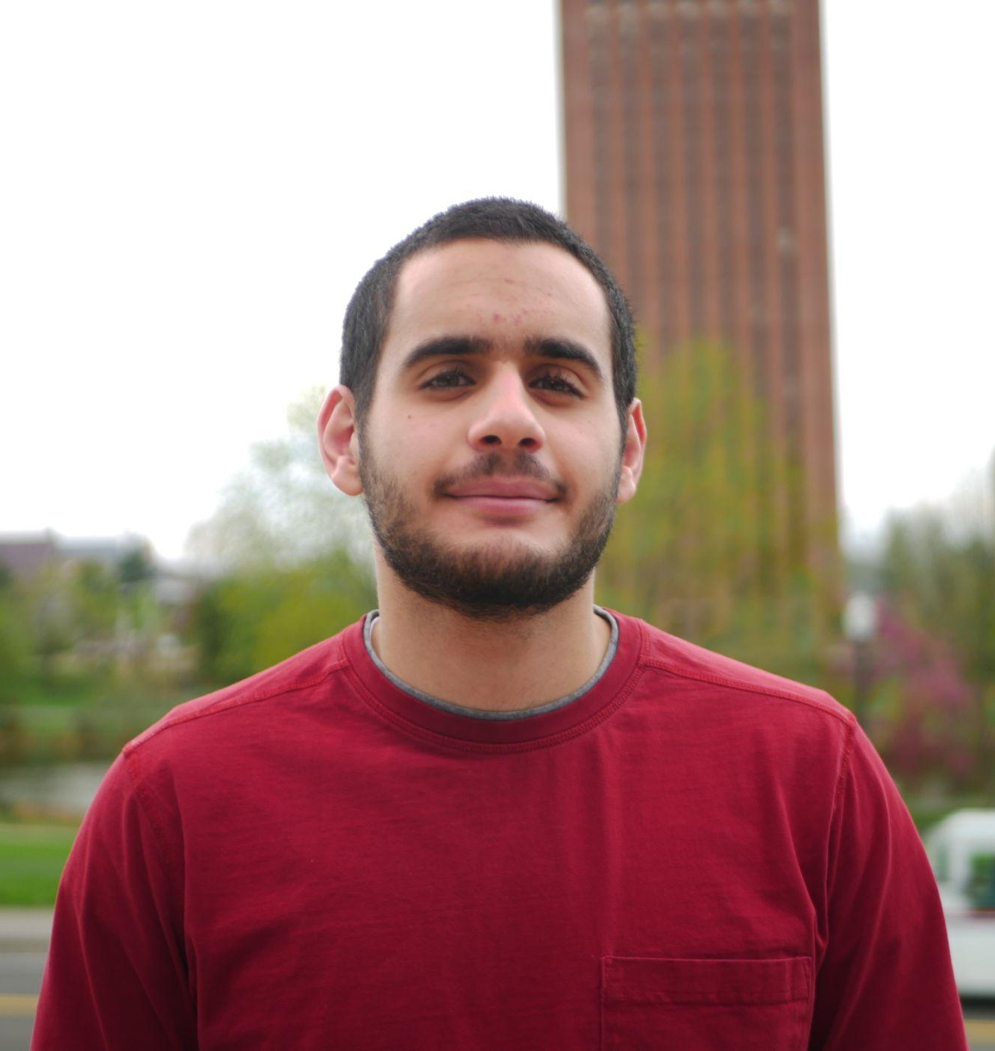




The Team
Omar Areiqat
CompE
Budget Lead
Movement and Power
Jina Song
EE
PCB Lead
Design
Vedatman Soham Basu CompE
Software Lead
Sensors
Redwan Rahman
CompE
Logistic Lead
Positioning
William Leonard
Advisor
Notes:
Individual

Slide 3

Problem Statement
Some people struggle with mundane actions in life, such as passing dishes on a large table.
Lazy Susans are nice, but only work on round tables and requires user to have reach.
What if there was a small, portable device that can move dishes across any table of arbitrary shape?
https://en.wikipedia.org/wiki/Lazy_Susan
Notes:
Soham

Slide 4
Our Solution
“Lazy Bob”: A moving coaster that approaches the user when called.
Stably transport items around a table to different users
Provide a simple way to interface with all coasters
Adapt to the environment
Notes:
Redwan

Slide 5

Purple: Caller
Yellow: Random Object
Plate 2
Coaster
Coaster
Coaster
θ
Coaster
Coaster
Coaster
Plate 5
r
Plate 1
HQ
Plate 3
Plate 4
Notes:
Omar

Slide 6
System Specifications: Functional
Mostly full container of liquid doesn’t spill when moving
Transport items without the items falling off
Detect the edges of the table and avoid falling off
Avoid objects that are in the coaster’s moving path
Arrive at the caller or hub to an accuracy of 10 cm
Support up to 3 lbs.
Test Plan
Place an 80% full glass/bowl of water and visibly check that the moving coaster doesn’t spill
Put objects on moving coaster and watch if object falls
Watch if the moving coaster falls off when caller is away from the table
Put objects in path and check if moving coaster bumps into object
Use a tape measure to check the distance from destination
Place an object that weighs 3 lbs and check if system is stable while moving
Notes:
Soham
- briefly point out, reminder from pdr

Slide 7
System Specifications: Design
Test Plan
7. Watch the moving coaster move towards hub on a
given signal
8. Call both coasters on a collision course and see if
they collide
9. Use tape measure to check coaster size
10. Find and put on irregular shaped tables and check
if they fall off
11. Line up objects to allow no path to caller, see if
system notifies caller
7. Move back to the coaster’s hub once determined
not in use
8. System supports at least 2 coasters at the same
time
9. Coaster diameter is within 25 cm
10. Be able to use the moving coaster regardless of
table shape
11. If no path to caller is available, indicate to caller
Notes:
Soham

Slide 8
MDR Deliverables
1 Moving Coaster
Moves properly and accurately
Accurately detects positioning
Goes to location when called
Detects and stops if an object is in the way
1 Caller
Can send signal to coaster and hub
1 Charging Hub - “Brains”
Can send signal to coaster and callers
Potentially charges system
D. Functional PCB
Microcontroller with user input method (button)
Notes:
Gina
No location calling due to unexpected delivery delay and facilitating it will be easier once client server system is set up

Slide 9
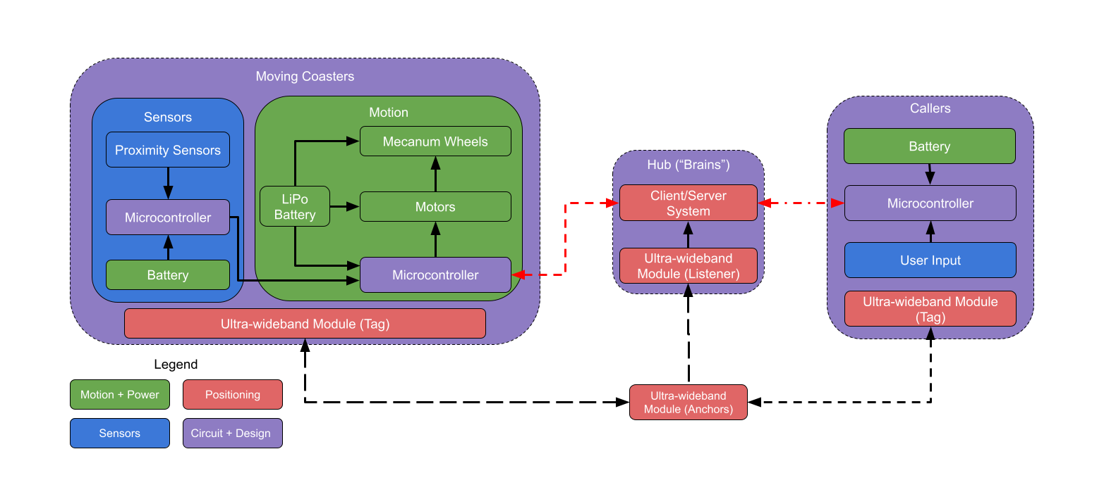
Hardware Block Diagram
Notes:
Gina

Slide 10
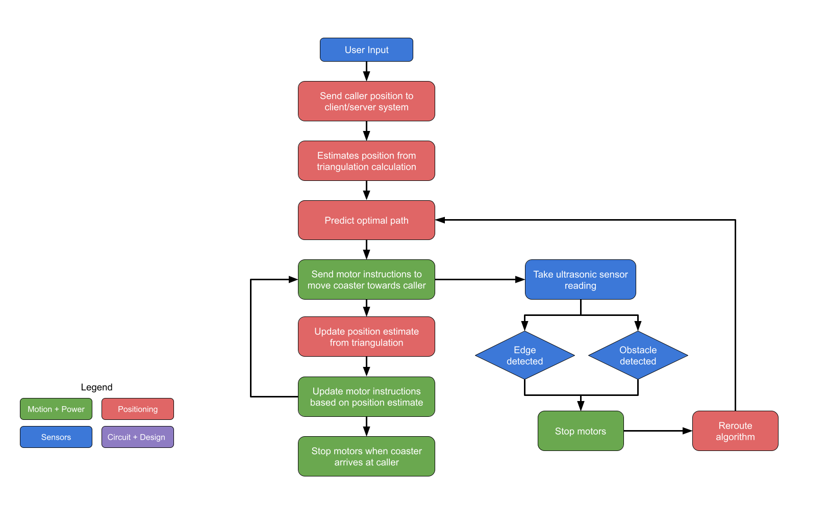
Software Block
Diagram
Notes:
Redwan
- The position updating and ultrasonic sensor happens in parallel

Slide 11
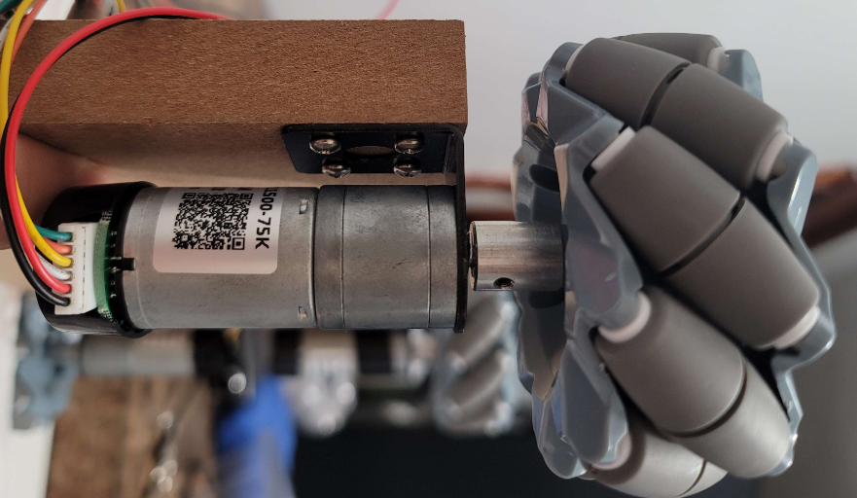
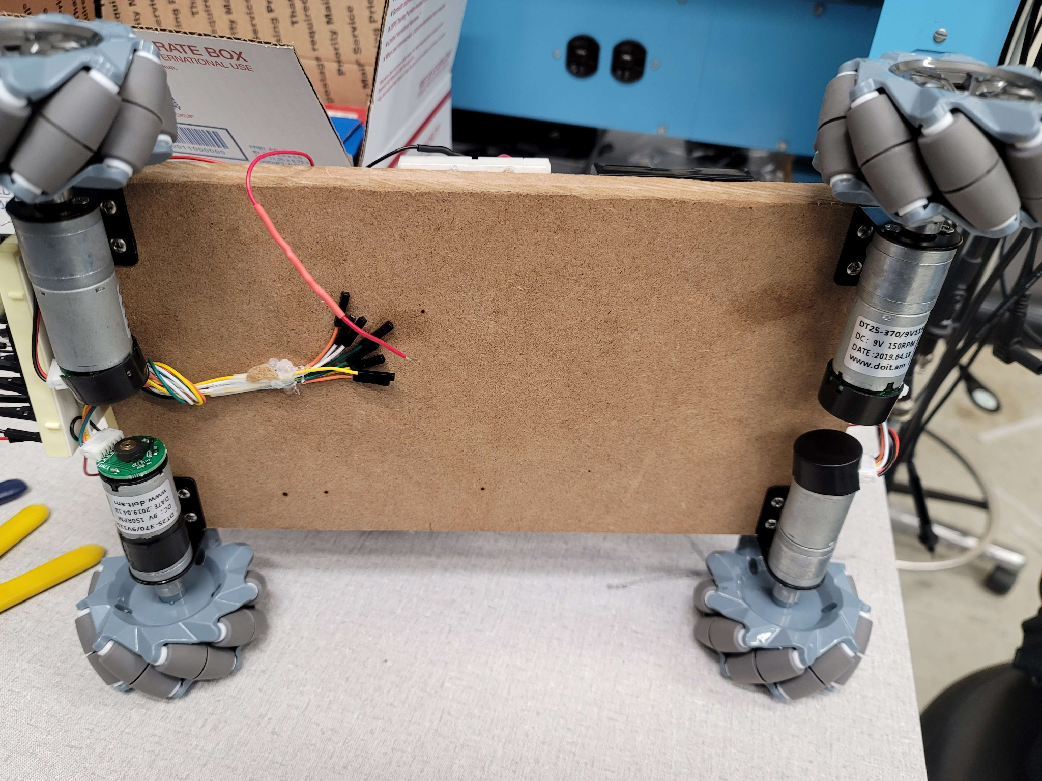
Subsystem: Motion
Notes:
Omar

Slide 12
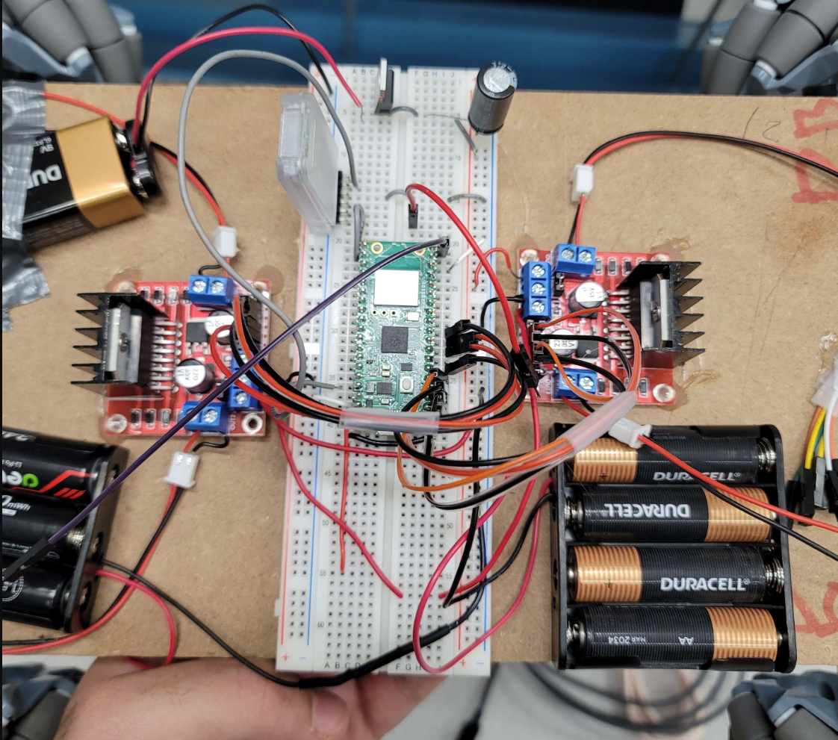
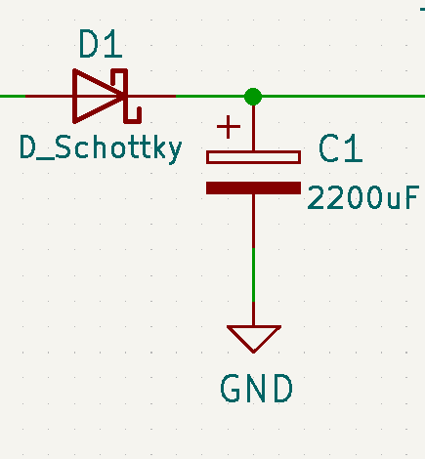
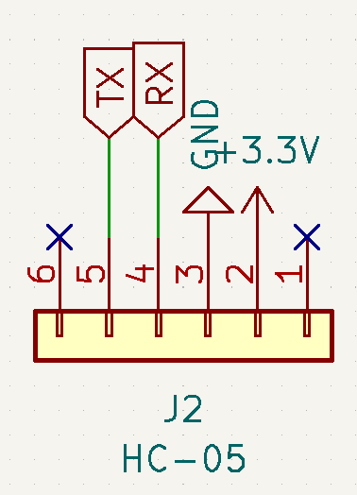
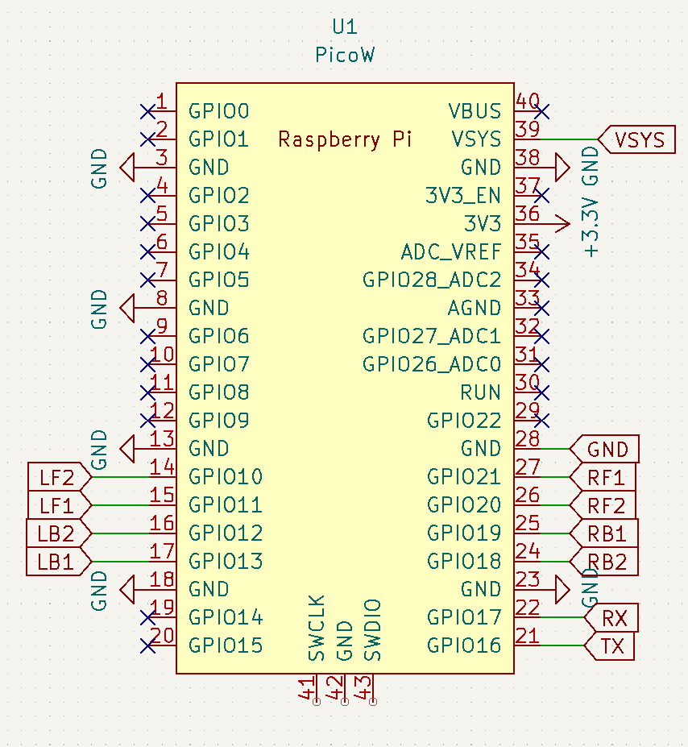
Motion: Circuit
Motor Driver
Notes:
Omar

Slide 13
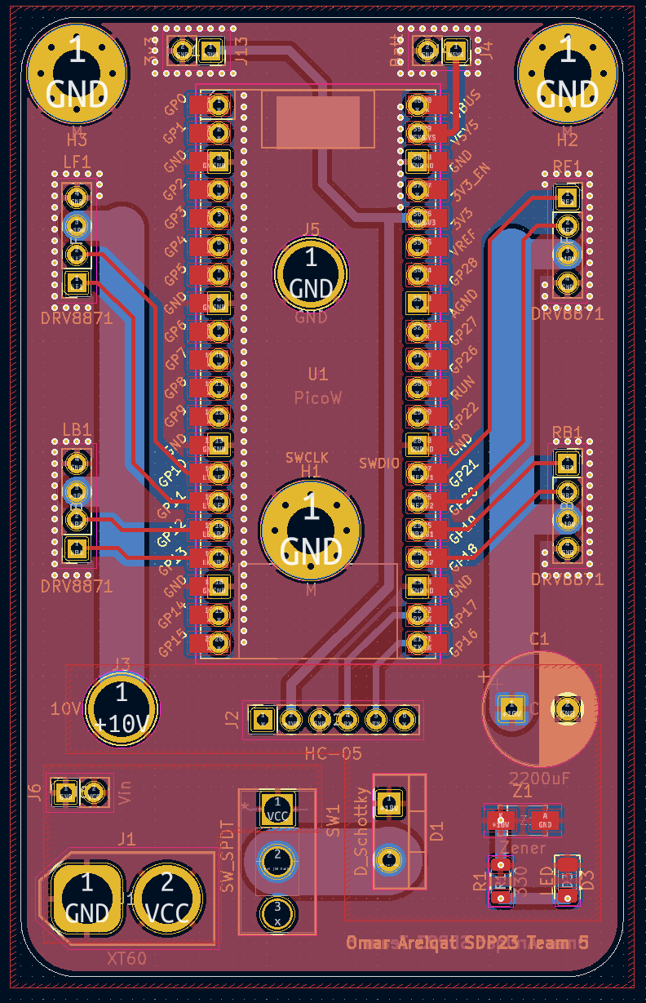
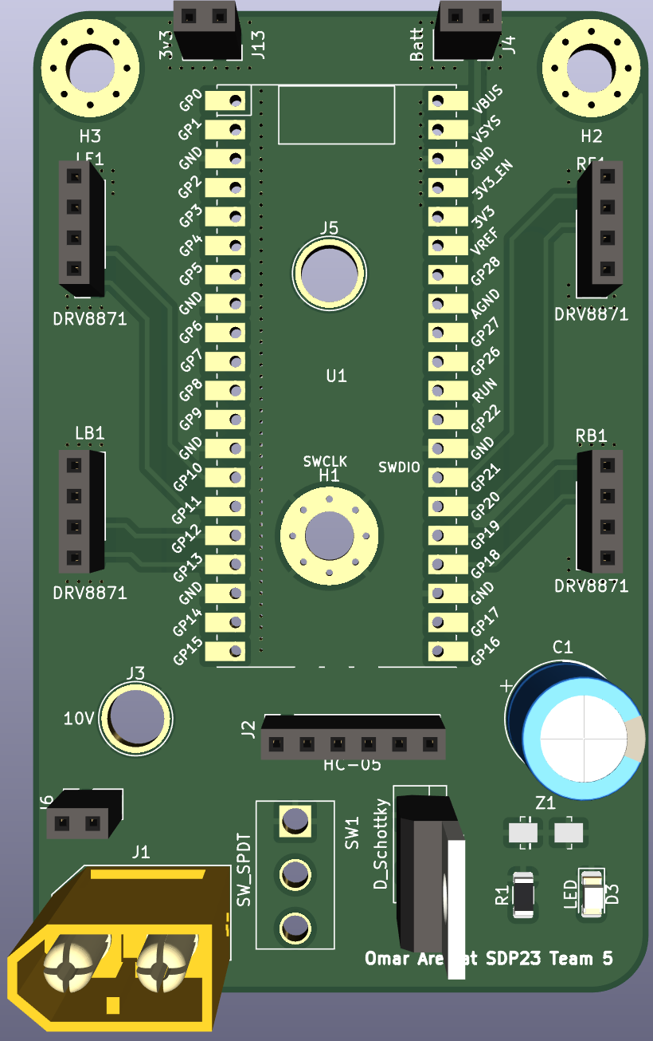
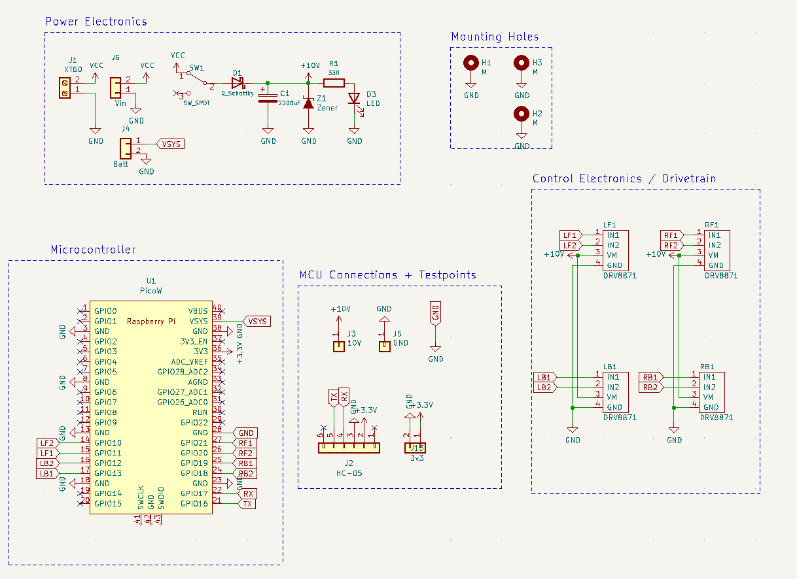
Motion: PCB
Notes:
Omar

Slide 14
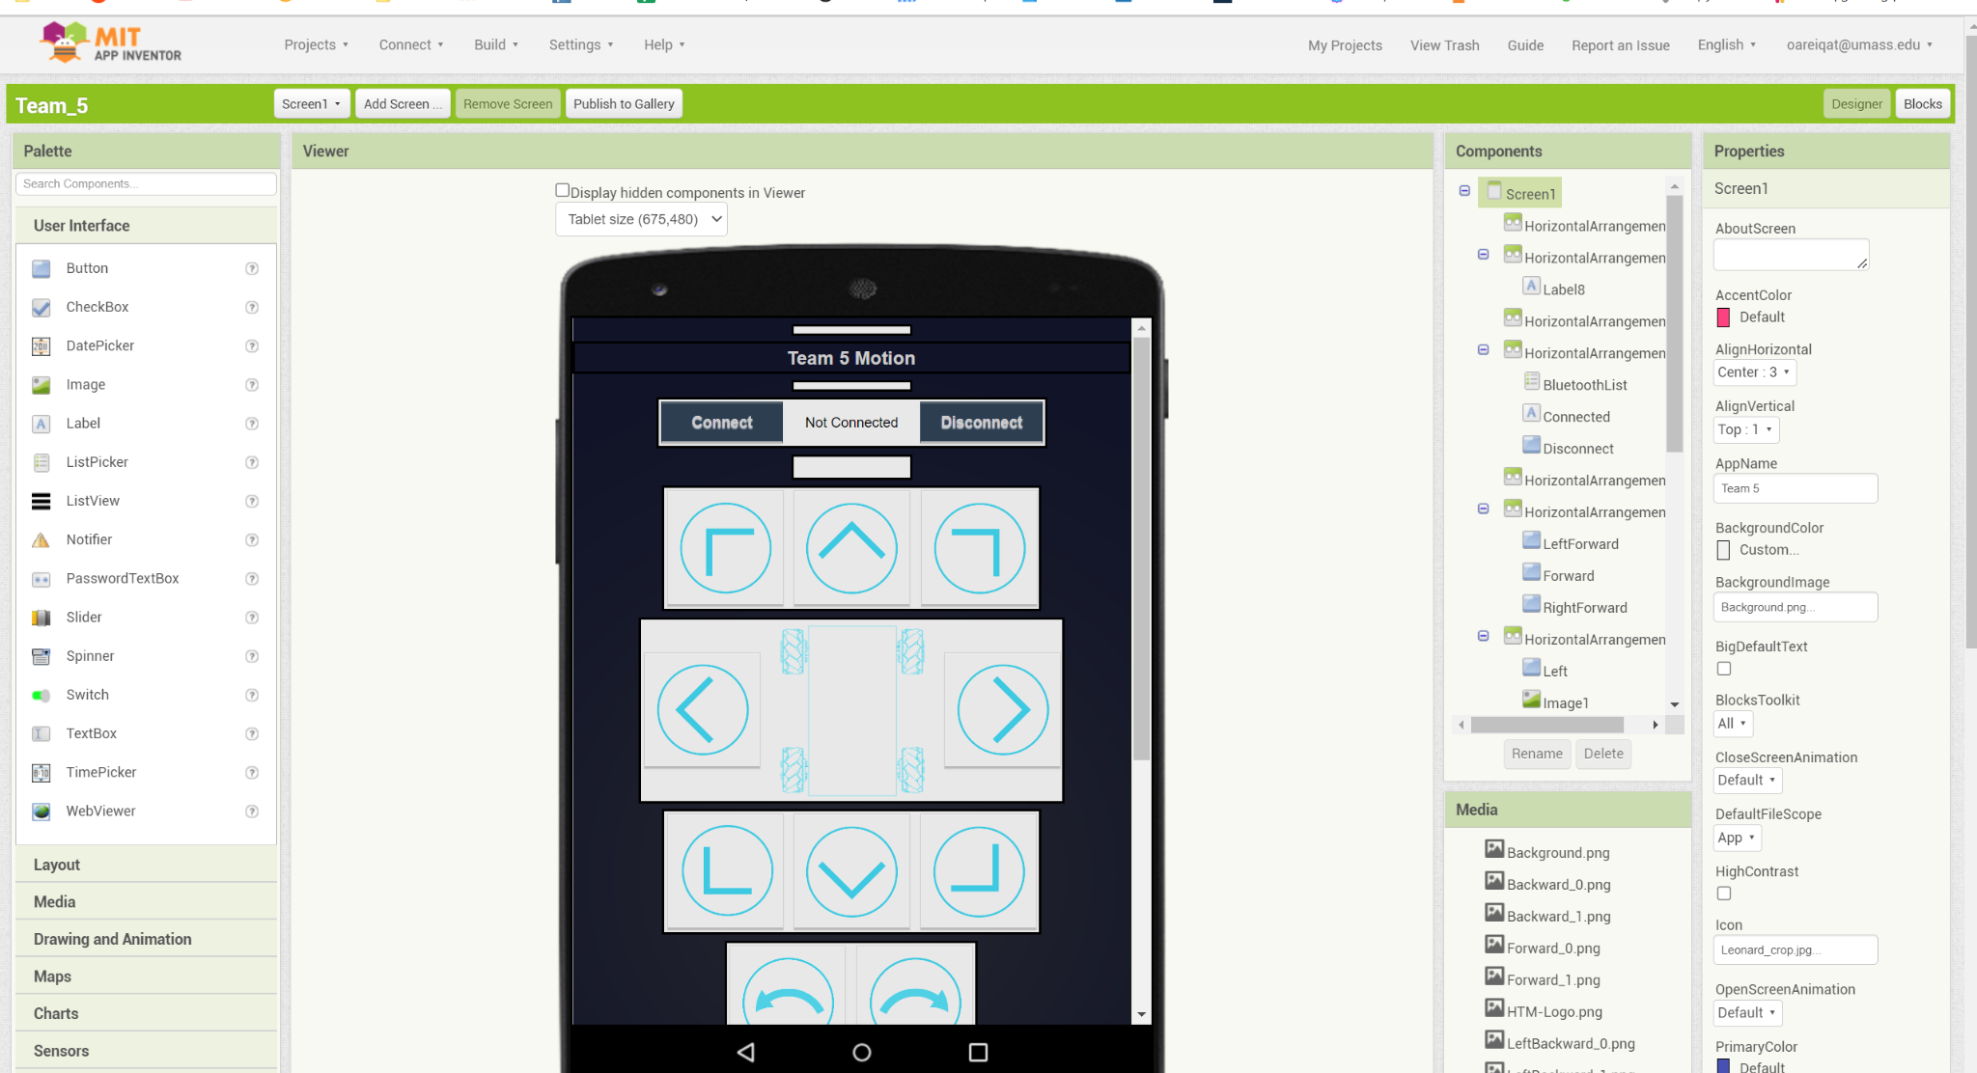
Motion: Debugging
https://appinventor.mit.edu
Notes:
Omar

Slide 15
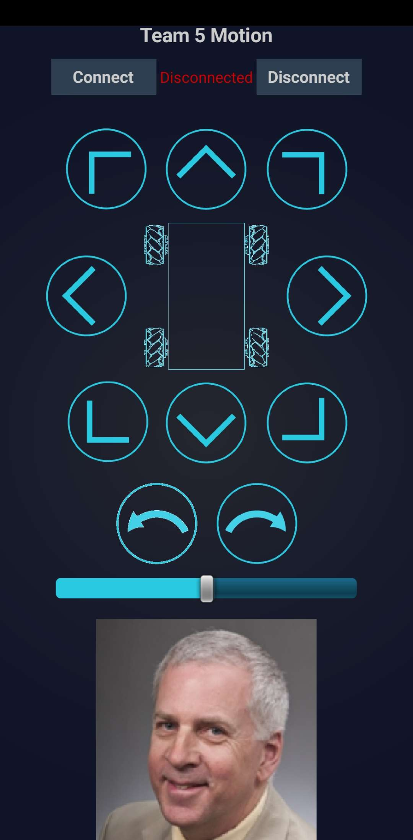
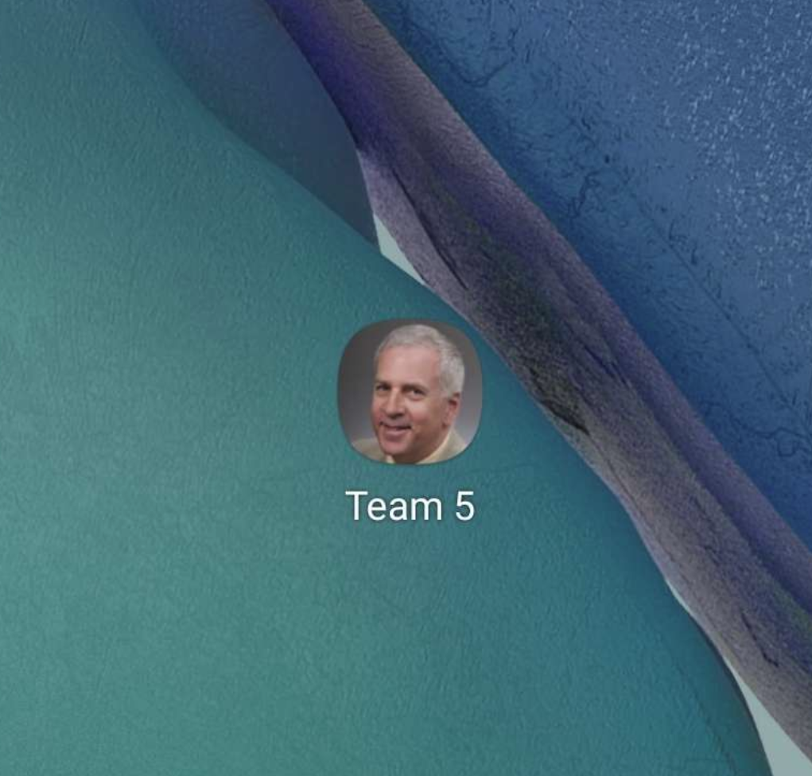
Motion: Debugging
Notes:
Omar

Slide 16
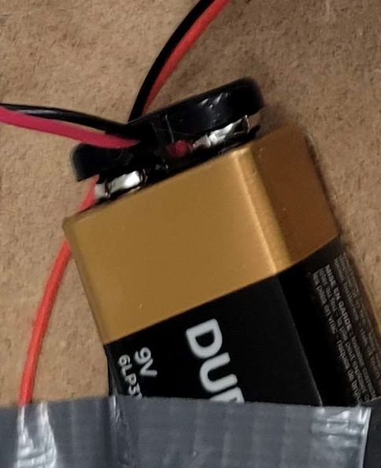
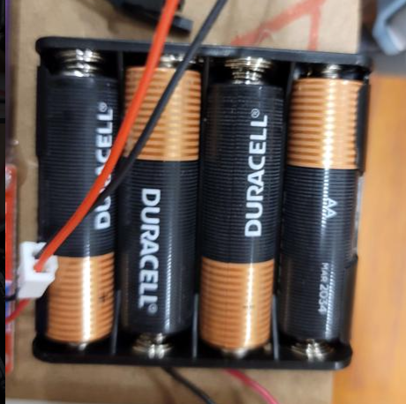
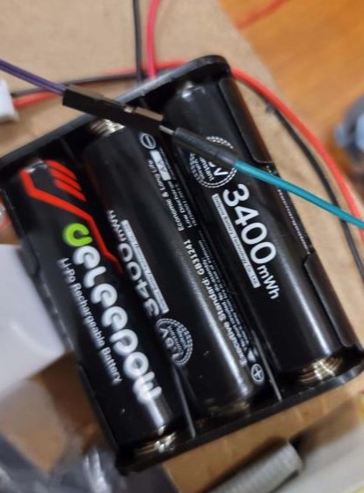
Subsystem: Power
Motor Driver Motor Power
Motor Driver Logic Power
MCU Power
https://www.adafruit.com/product/328
https://www.adafruit.com/product/798
Notes:
Omar

Slide 17
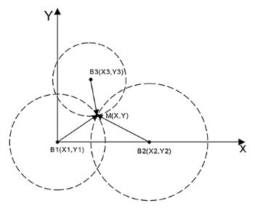
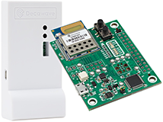
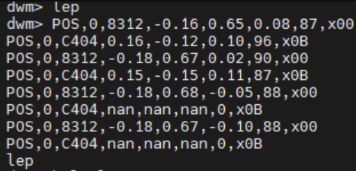
Subsystem: Positioning
Ultra Wideband Sensor
Accuracy to 土1 cm
Program gives confidence level
Triangulating relative position
Get position of both individually
on an x,y,z plane and calculate
https://www.frontiersin.org/articles/10.3389/fnbot.2022.715440/full
https://www.qorvo.com/products/p/MDEK1001
Notes:
Redwan
Explain calibration - “we know”

Slide 18
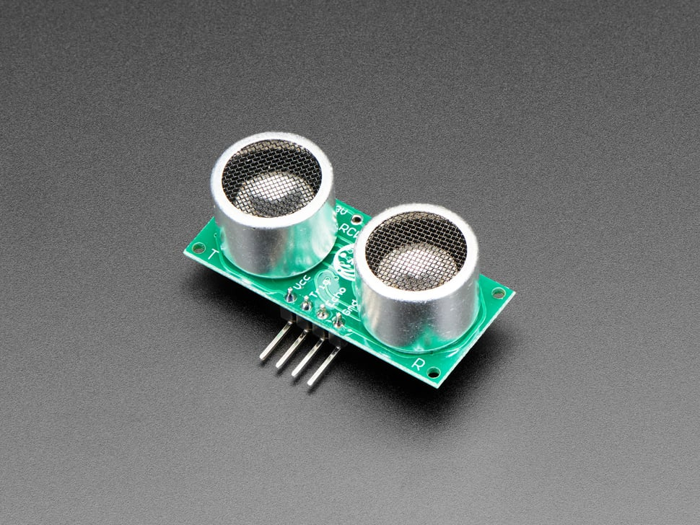
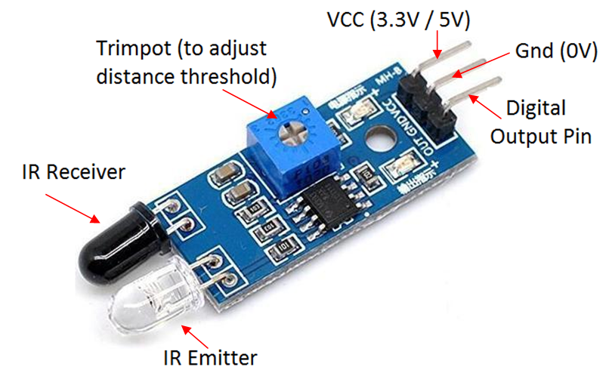
Subsystem: Collision and Cliff Detection
Ultrasonic
Edge detection
Clear path and obstacle detection
Infrared/Piezoelectric
Collision and impassable barrier detection
Notes:
Soham

Slide 19

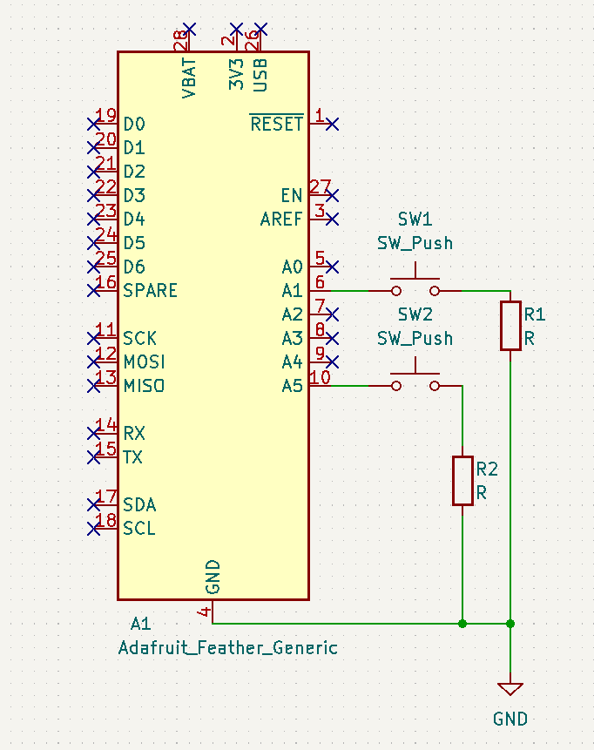
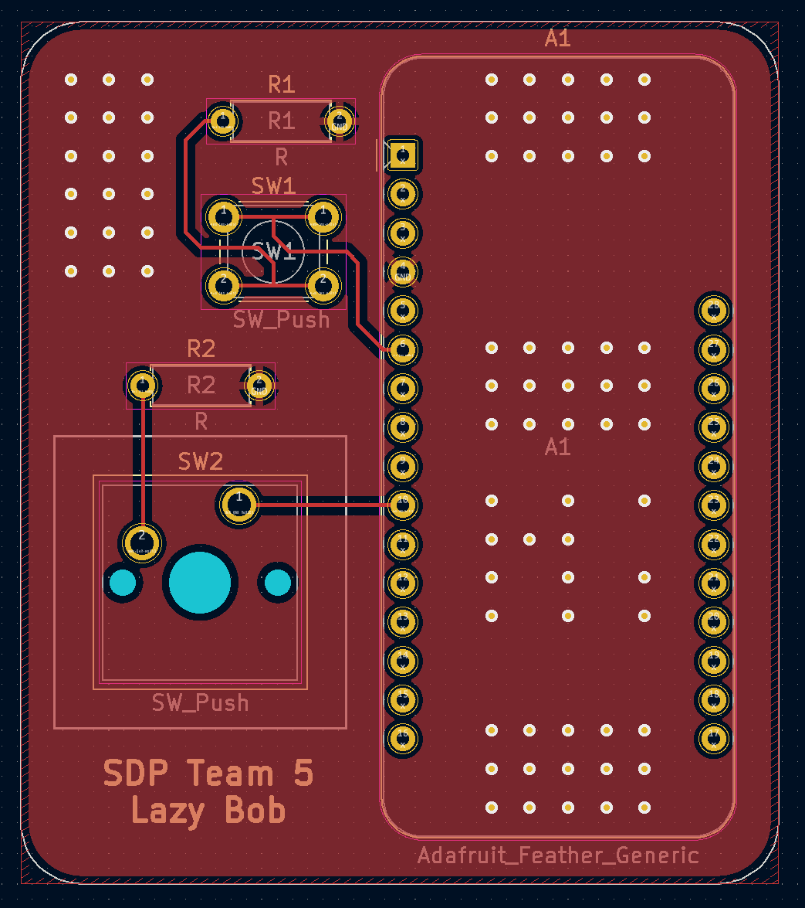
Design: Chassis and PCB
Notes:
Gina

Slide 20
CDR Deliverables
2. Chassis for Coaster
a. Circular body with a
platform to put objects on
b. Able to contain all
components inside
3. PCB Plans
a. Motion
b. Sensors
c. User input
“The Brains” and Live Data
Instead of laptop, use Raspberry Pi or similar to process data
Setup client/server system for inputs from multiple sources
Continuously update position as coaster moves (Currently uses first set of coordinates to move)
Notes:
Redwan

Slide 21
Next Semester Estimated Cost
Planned List
Item Name | Link | Price $ (with tax and shipping)
Raspberry Pi 4 | SDP | –0–
PCB | JLCPCB | 50.00
Sensors | M5 | 25.00
Motion PCB | Omar | –0–
4 x DRV8871 Motor Drivers | M5 | –0–
1s 1500mAh Lipo | M5 | –0–
216.95
Notes:
Omar

Slide 22
Total Expenses to-date
Total List
Item Name | Source | Price $ (with tax and shipping)
UWB DIY Starter Kit | Link | 74.98
2 x Pico W | Wouter | 12.00
PCB1 | Wouter | 22.05
PCB | JLCPCB | 50.00
Sensors | M5 | 25.00
6 x Pico W | Wouter | 36.00
6 Dof Sensors | Amazon | 15.95
12 x RCR132a | Amazon | 40.00
Motors and Wheels | Digikey/Adafruit | 50.00
325.98
Notes:
Omar

Slide 23
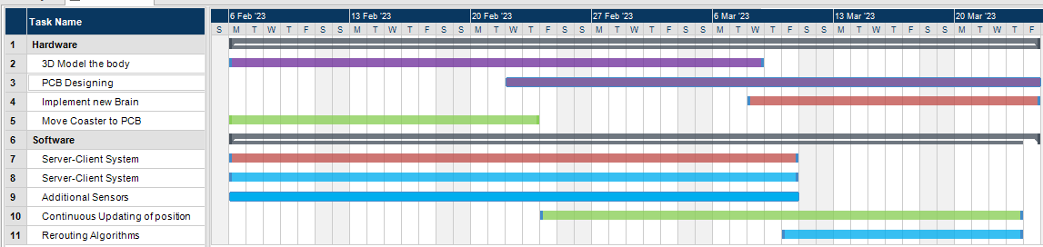
Gantt Chart
Notes:
Redwan

Slide 24
QUESTIONS & ANSWERS

Slide 25
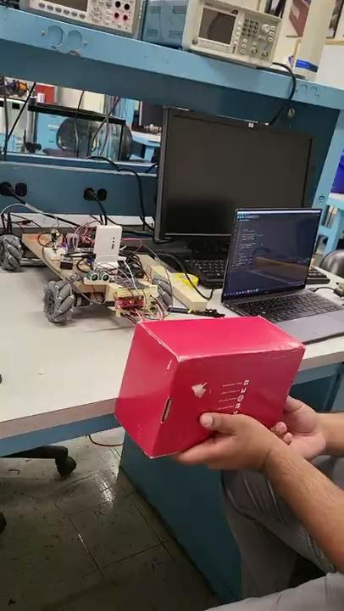
Video (if things go awry)

